Slide 1
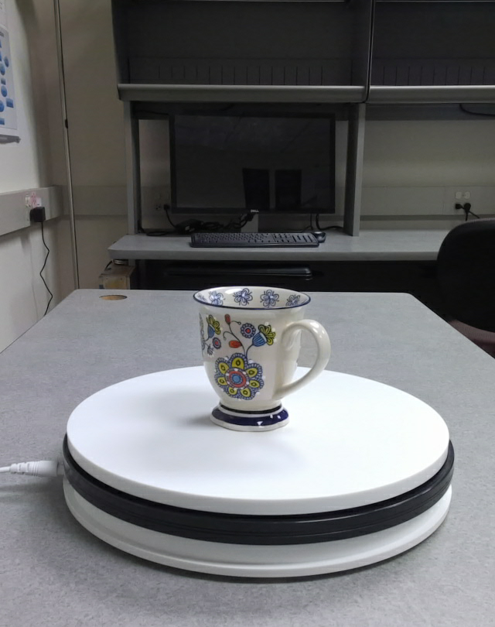
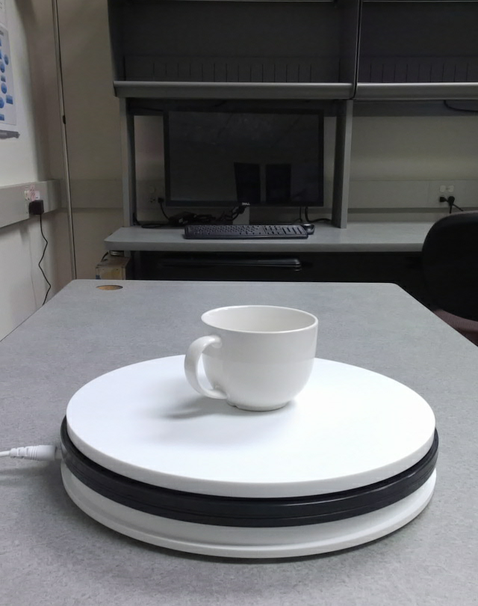
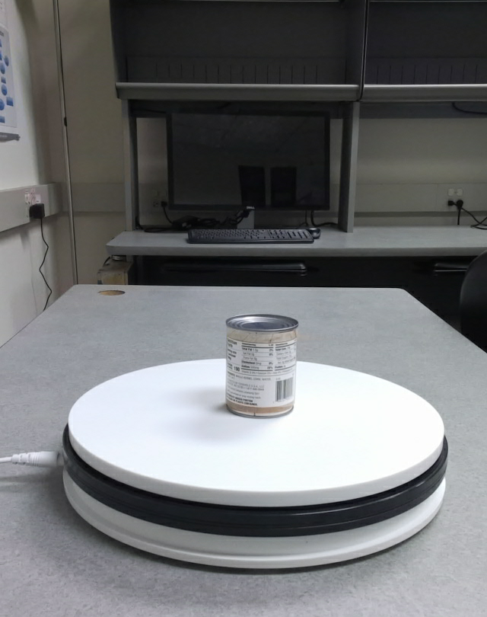
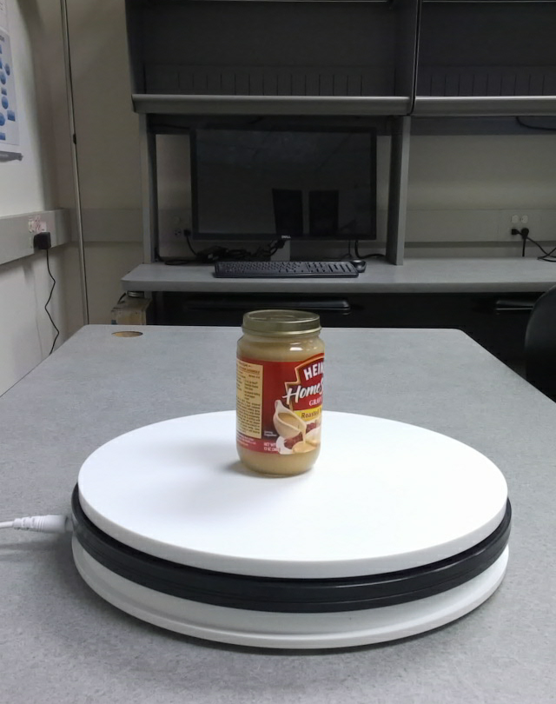
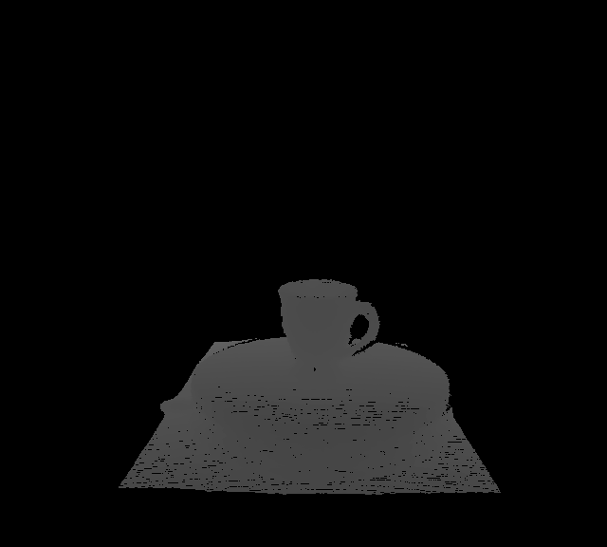
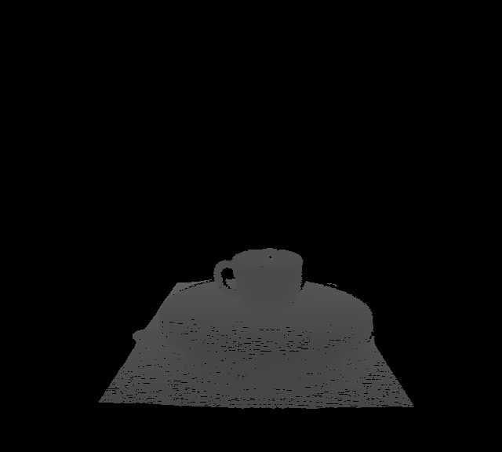
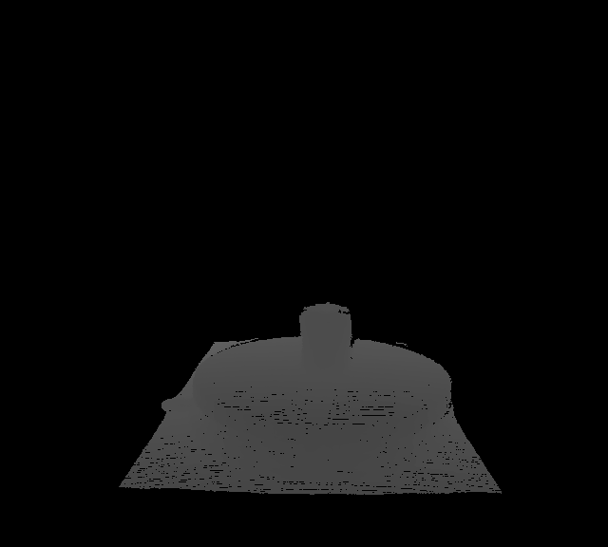


ResNet152
Vision Alignment Model
ResNet152
t
Speech Alignment Model
wav2vec2.0
Shared Latent Space
I am seeing a white mug

Slide 2
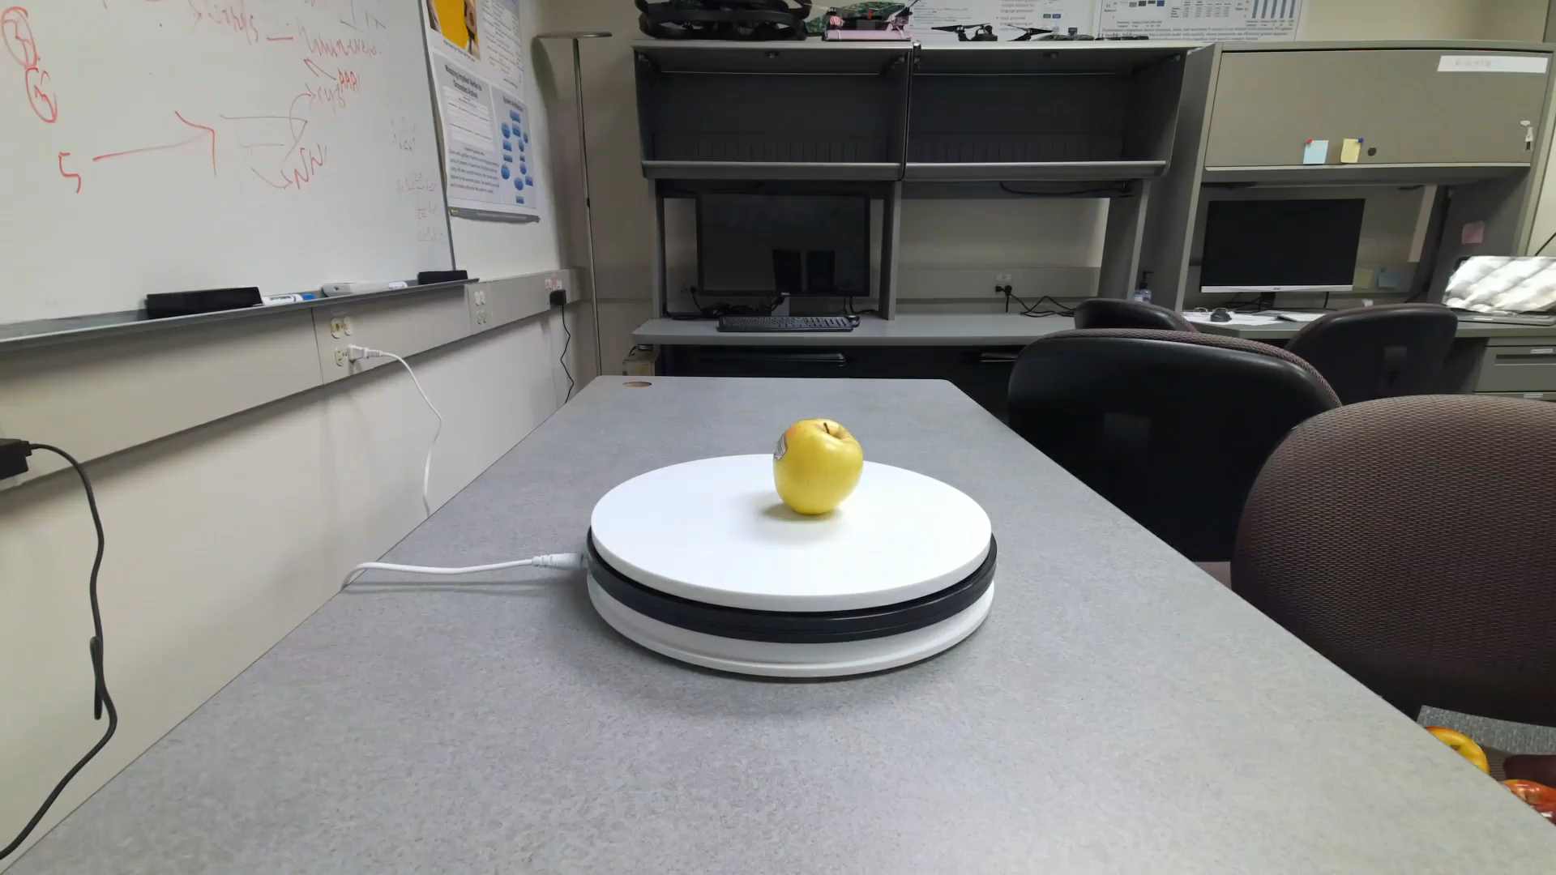
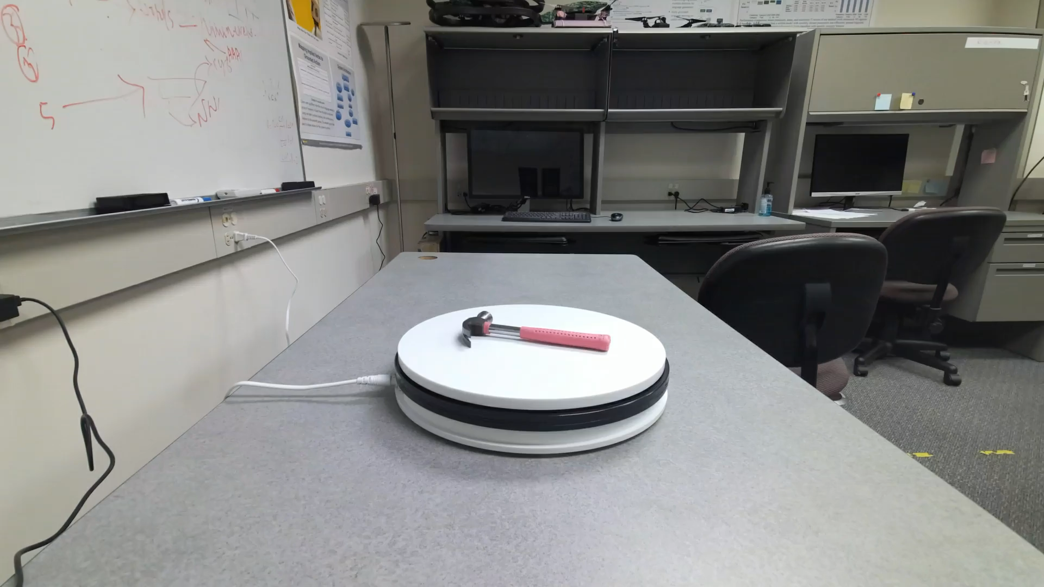
207 unique objects
47 object classes
5 High level categories: Food, Home, Medical, Office, Tools
16500 Typed Descriptions
16500 Spoken Descriptions

Slide 3
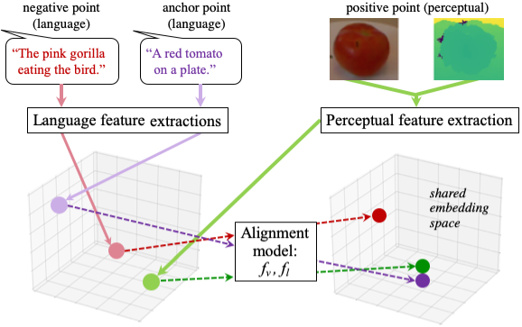

Slide 4

Masked Language Modeling + Next Event Sequence Prediction
[CLS]
(Verb
Subject
Object
Modifier)
…
[SEP]
…
[MASK]
…
Event Sequence 1
Event Sequence 2

Slide 5






BERT
XLNet
I came to work for no reason 😫🔫
Woah. That overtime was exhilarating!

Slide 6
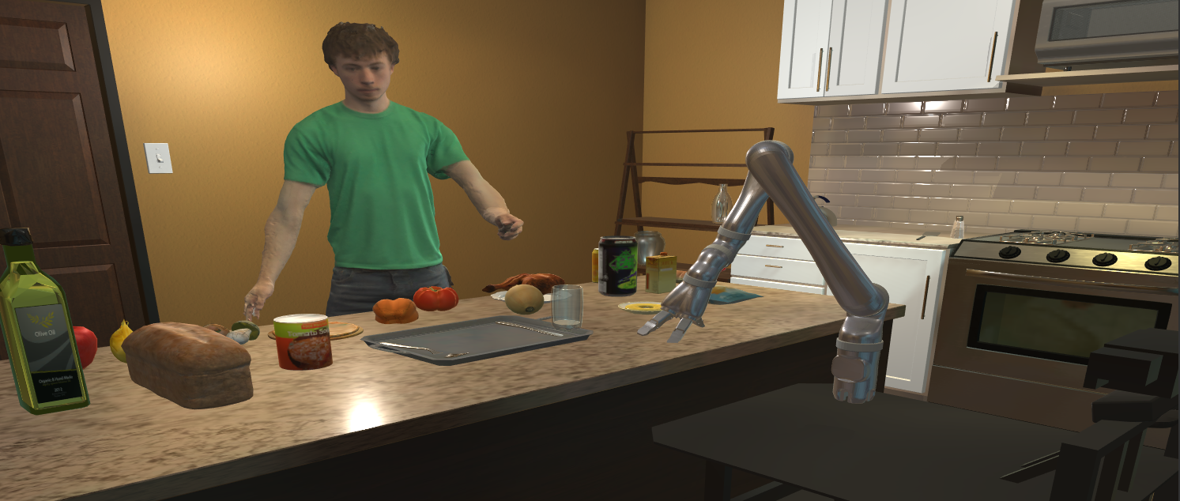
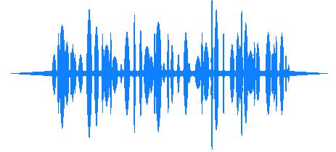
Pick the bread and place it on the counter

